Slide 1
Amplitude Modulation
Sujoy Mukherjee
sujoymukherjee@ieee.org

Slide 2
Content
What is Modulation
Amplitude Modulation (AM)
Demodulation of AM signals
Calculation and Examples
Summary
..

Slide 3
What is Modulation
Modulation
  In the modulation process, some characteristic of a high-frequency carrier signal (bandpass), is changed according to the instantaneous amplitude of the information (baseband) signal.
Why Modulation
  Suitable for signal transmission (distance…etc)
  Multiple signals transmitted on the same channel
  Capacitive or inductive devices require high frequency AC input (carrier) to operate.
  Stability and noise rejection
..

Slide 4
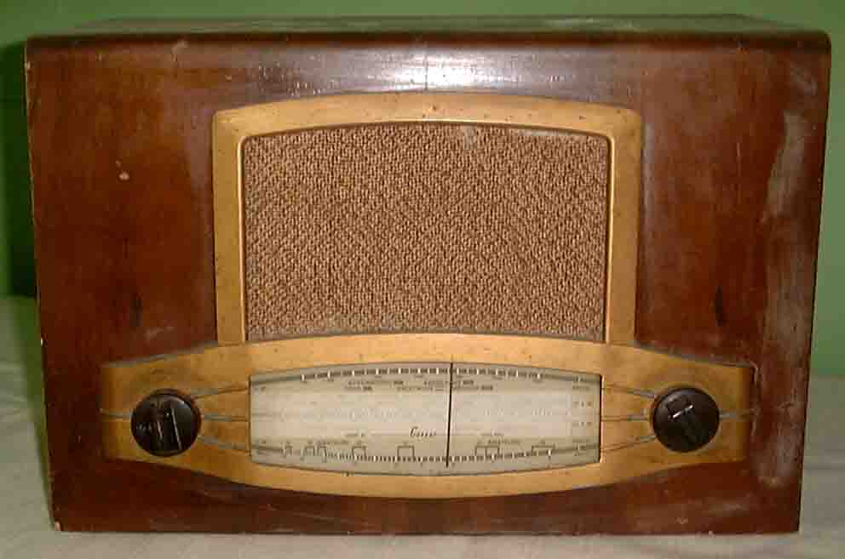
About Modulation
Application Examples
  broadcasting of both audio and video signals.
  Mobile radio communications, such as cell phone.
Basic Modulation Types
  Amplitude Modulation: changes the amplitude.
  Frequency Modulation: changes the frequency.
  Phase Modulation: changes the phase.
..

Slide 5


AM Modulation/Demodulation
Source
Sink
Channel
Modulator
Demodulator
Baseband Signal
with frequency
f_{m}
(Modulating Signal)
Bandpass Signal
with frequency
f_{c}
(Modulated Signal)
Original Signal
with frequency
f_{m}
f_{c} >> f_{m}
Voice: 300-3400Hz GSM Cell phone: 900/1800MHz
..

Slide 6
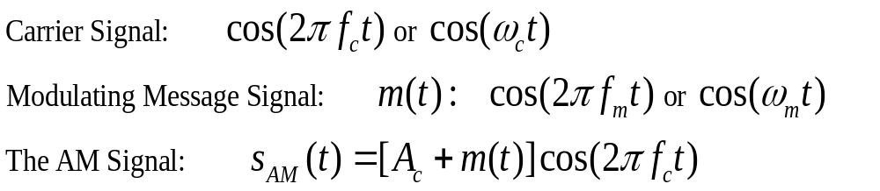
Amplitude Modulation
The amplitude of high-carrier signal is varied according to the instantaneous amplitude of the modulating message signal m(t).
..

Slide 7
* AM Signal Math Expression*
Mathematical expression for AM: time domain
expanding this produces:
In the frequency domain this gives:
Carrier, A=1.
Amplitude
k/2
k/2
frequency
lower sideband
f_{c}-f_{m}
f_{c}
f_{c}+f_{m}
upper sideband
..

Slide 8
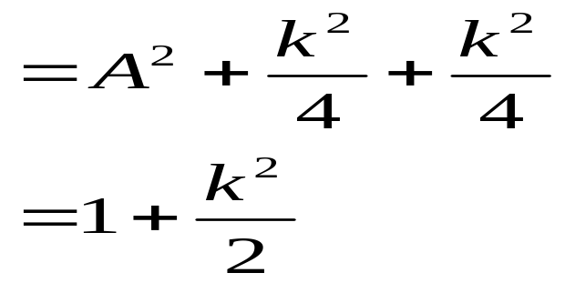
AM Power Frequency Spectrum
AM Power frequency spectrum obtained by squaring the amplitude:
Total power for AM:
Carrier, A²=1² = 1
Power
k²/4
k²/4
f_{c}-f_{m}
f_{c}
f_{c}+f_{m}
freq
.
..

Slide 9
Amplitude Modulation
The AM signal is generated using a multiplier.
All info is carried in the amplitude of the carrier, AM carrier signal has time-varying envelope.
In frequency domain the AM waveform are the lower-side frequency/band (f_{c} - f_{m}), the carrier frequency f_{c}, the upper-side frequency/band (f_{c} + f_{m}).
..

Slide 10
AM Modulation – Example
The information signal is usually not a single frequency but a range of frequencies (band). For example, frequencies from 20Hz to 15KHz. If we use a carrier of 1.4MHz, what will be the AM spectrum?
In frequency domain the AM waveform are the lower-side frequency/band (f_{c} - f_{m}), the carrier frequency f_{c}, the upper-side frequency/band (f_{c} + f_{m}). Bandwidth: 2x(25K-20)Hz.
1.4 MHz
frequency
f_{c}
1,400,020Hz to 1,415,000Hz
1,385,000Hz to 1,399,980Hz
..

Slide 11
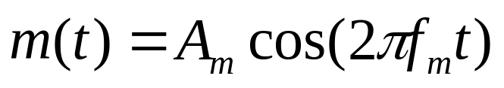

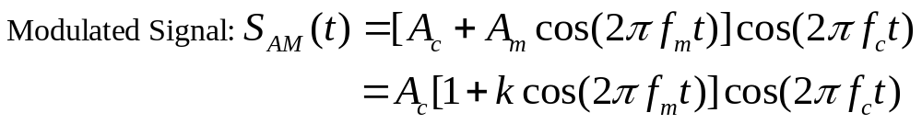
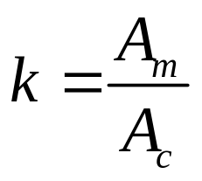
Modulation Index of AM Signal
For a sinusoidal message signal
Modulation Index is defined as:
Modulation index k is a measure of the extent to which a carrier voltage is varied by the modulating signal. When k=0 no modulation, when k=1 100% modulation, when k>1 over modulation.
..

Slide 12
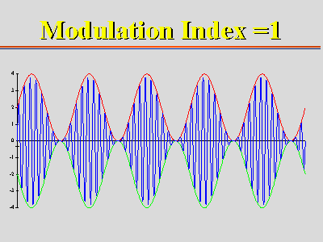
Modulation Index of AM Signal
..

Slide 13
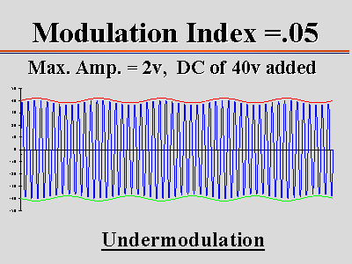
Modulation Index of AM Signal
..

Slide 14
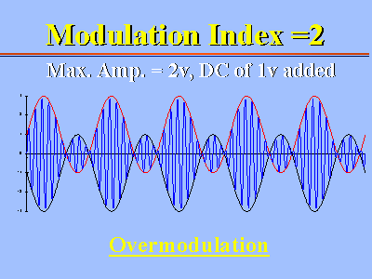
Modulation Index of AM Signal
..

Slide 15
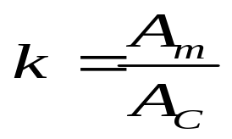
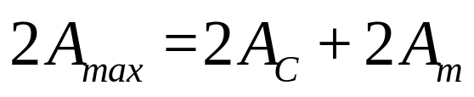
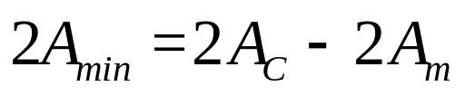
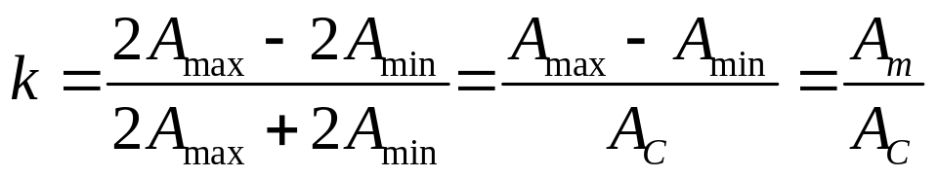
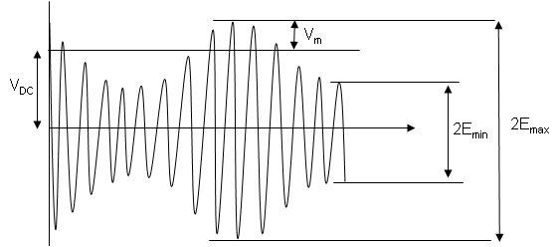
Modulation Depth
2A_{max} = maximum peak-to-peak of waveform
2A_{min} = minimum peak-to-peak of waveform
This may be shown to equal
as follows:
_{Am}
_{Ac}
_{2Amin}
_{2Amax}
..

Slide 16
High Percentage Modulation
It is important to use as high percentage of modulation as possible (k=1) while ensuring that over modulation (k>1) does not occur.
The sidebands contain the information and have maximum power at 100% modulation.
Useful equation
P_{t} = P_{c}(1 + k²/2)
P_{t} =Total transmitted power (sidebands and carrier)
P_{c} = Carrier power
..

Slide 17
Example
Determine the maximum sideband power if the carrier output is 1 kW and calculate the total maximum transmitted power.
Max sideband power occurs when k = 1. At this percentage modulation each side frequency is ½ of the carrier amplitude. Since power is proportional to the square of the voltage, each has ¼ of the carrier power. ¼ x 1kW = 250W Total sideband power = 2 x 250 = 500W. Total transmitted power = 1kW + 500W = 1.5kW
..

Slide 18
Demodulation of AM Signals
Demodulation extracting the baseband message from the carrier.
There are 2 main methods of AM Demodulation:
Envelope or non-coherent detection or demodulation.
Synchronised or coherent demodulation.
..

Slide 19
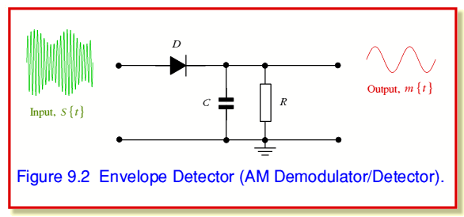
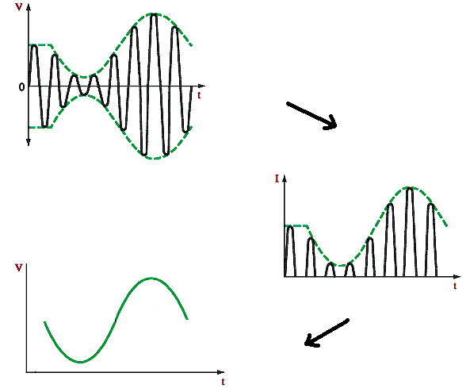
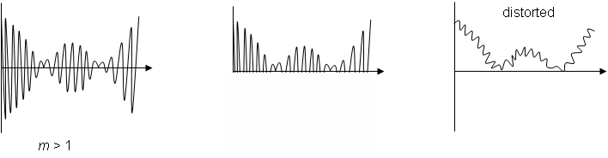
Envelope/Diode AM Detector
If the modulation depth is > 1, the distortion below occurs
K>1
..

Slide 20
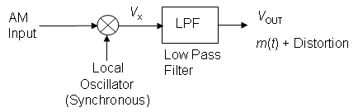
Synchronous or Coherent Demodulation
This is relatively more complex and more expensive. The Local Oscillator (LO) must be synchronised or coherent, i.e. at the same frequency and in phase with the carrier in the AM input signal.
..

Slide 21
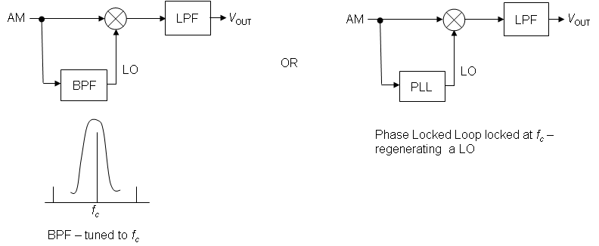
Synchronous or Coherent Demodulation
If the AM input contains carrier frequency, the LO or synchronous carrier may be derived from the AM input.
..

Slide 22
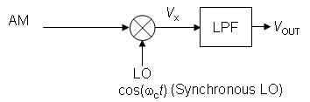

Synchronous or Coherent Demodulation
If we assume zero path delay between the modulator and demodulator, then the ideal LO signal is cos(ω_{c}t).
Analysing this for a AM input =
..

Slide 23


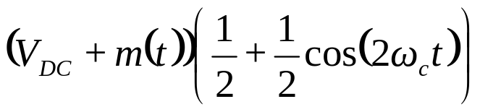
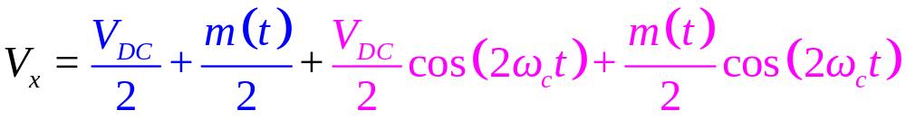
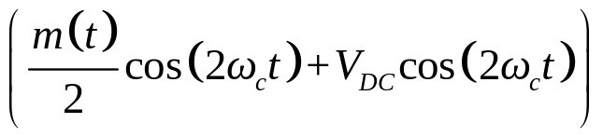
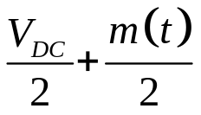
Coherent Detection
Assume zero path delay between the modulator and demodulator:
V_{X} = AM input x LO
=
=
=
Note – the AM input has been 'split into two' – ‘red part' has moved or shifted up to higher frequency:
and blue part shifted down to baseband:
..

Slide 24
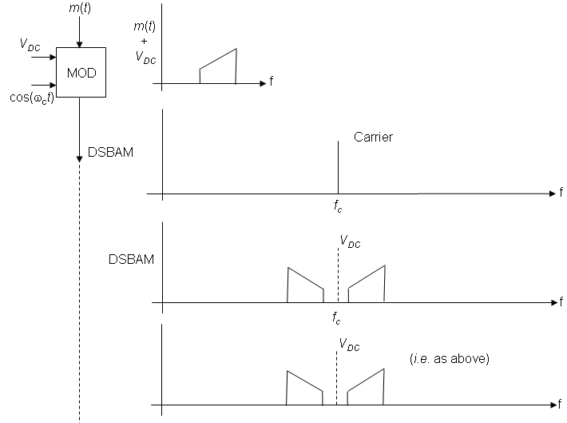
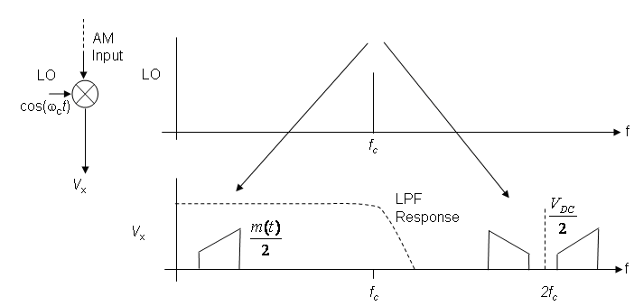
Coherent Detection
..

Slide 25
Diode v.s Coherent
Diode-: Unable to follow fast-modulation properly
Diode-: Power is absorbed from the tuned circuit by the diode circuit.
Diode-: Distortion produced is not acceptable for some communications.
Diode+: Obviously simple, low cost.
Coherent+: Low Distortion
Coherent+: Greater ability to follow fast-modulation.
Coherent+: The ability to provide power gain
Coherent-: Complex and expensive
..

Slide 26
Exercises: Draw the Spectrums
a) cos(ω_{c}t)cos(ω₁t)
from cosAcosB= 1/2[cos(A-B)+cos(A+B)]
we get: cos(ω_{c}t)cos(ω₁t)=1/2[cos(ω_{c}-ω₁)t + cos(ω_{c}+ω₁)t]
Hence the spectrum of this is:
b) cos²ωt
from cos²A=1/2[1+cos2A]
we get: cos²ωt=1/2[1+cos2ωt]
The spectrum is thus:
amplitude
1/2
1/2
ω_{c}-ω₁
ω_{c}+ω₁
frequency
1/2
1/2
DC=0Hz
2ω
freq
..

Slide 27
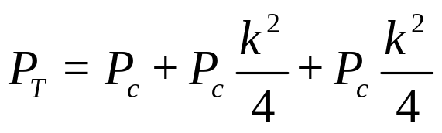
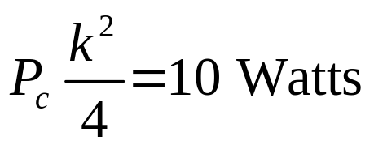
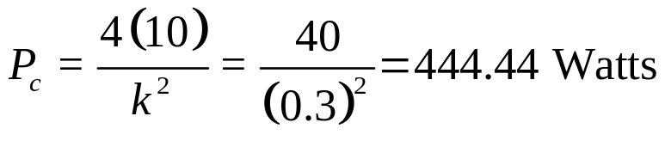
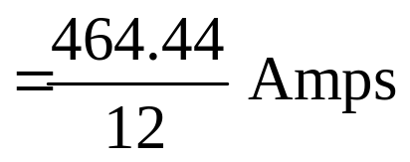
Example
Suppose you have a portable (for example you carry it in your ' back pack') AM transmitter which needs to transmit an average power of 10 Watts in each sideband when modulation depth k = 0.3. Assume that the transmitter is powered by a 12 Volt battery. The total power will be
where
Hence, total power P_{T} = 444.44 + 10 + 10 = 464.44 Watts.
Hence, battery current (assuming ideal transmitter) = Power / Volts =
A large and heavy 12 Volt battery!!!!
Suppose we could remove one sideband and the carrier, power transmitted would be 10 Watts, i.e. 0.833 amps from a 12 Volt battery, which is more reasonable for a portable radio transmitter. (Single Side Band)
..

Slide 28
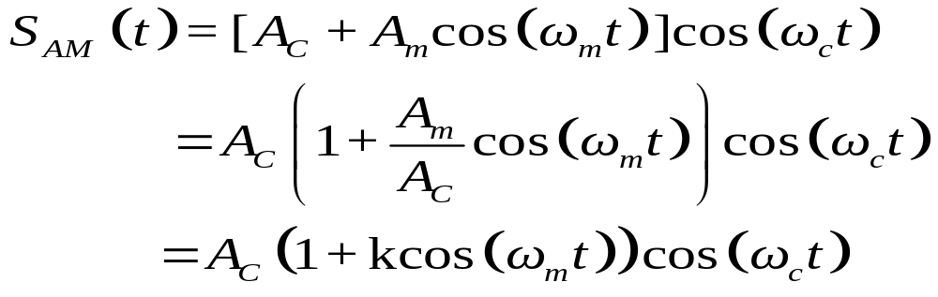
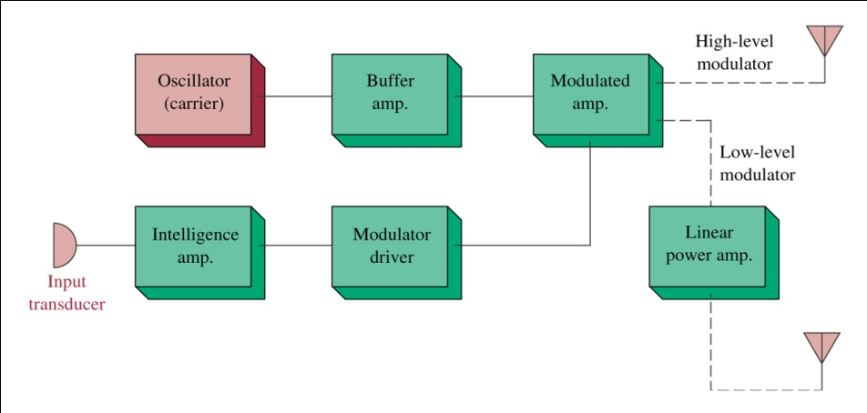
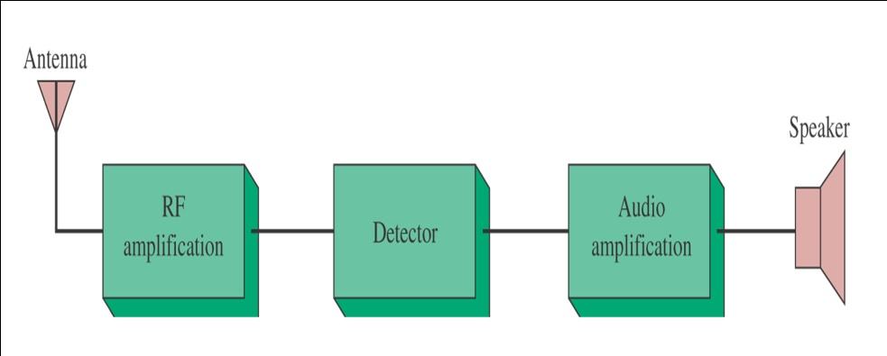
AM Transmitter and Receiver
..

Slide 29
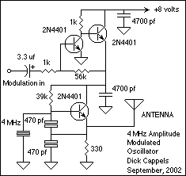
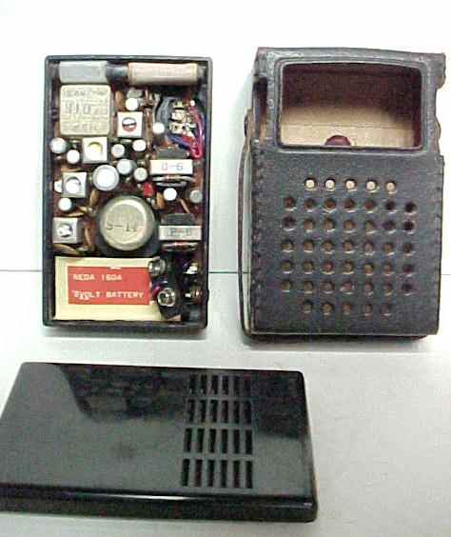
AM Transmitter and Receiver
..

Slide 30
Summary
Modulation, Amplitude Modulation
Modulation Index, Modulation Depth
Demodulation of AM signals
Calculation and Examples
Math: AM Time domain+Frequency domain
Calculation: AM Power, AM Demodulation
Next Class….
DSB, SSB, VSB……
FM, PM
..

